Slide 1


E-commers Customer Service Satisfaction
Name: Ali Ahmed Ali
Page
1/12

Slide 2

Introduction
Content
Analysis
Recommendation
Page
2/12

Slide 3
Introduction
I chose data from the site (Kaggle) the link:
https://www.kaggle.com/datasets/ddosad/ecommerce-customer-service-satisfaction
Note: original information has been obscured, and the dataset has been fabricated to ensure that the original details are hidden.
the Topic Title is (eCommerce Customer Service Satisfaction) for shop sit his name is shopzilla.
Problem Statement
Shopzilla is shopping site.
Shopzilla is shopping site want to understand consumer behavior and evaluate the effectiveness of customer service to maintain their reputation for customer service.
Page
3/12

Slide 4
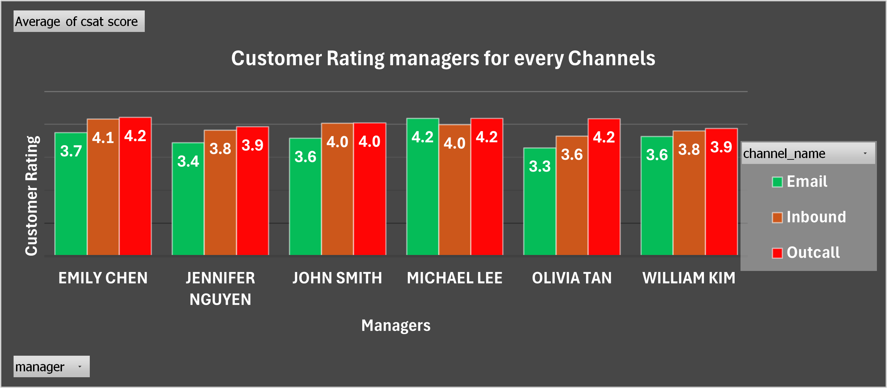

How effective are managers at managing communication channels
All Managers are almost at 4 Customer Rating in (Inbound) and (Outcall), except (Email) is lower than 4
Page
4/12

Slide 5
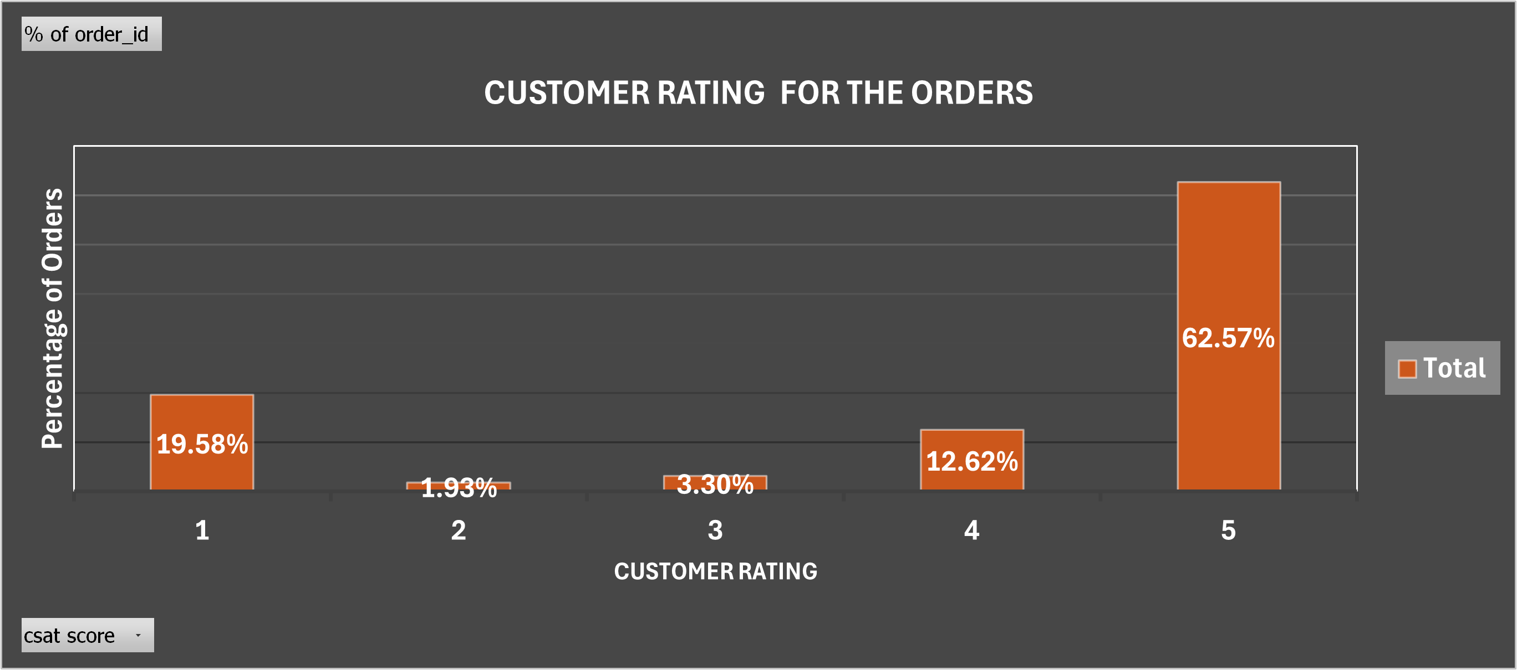

How many orders for each Customer Rating do they get?
while a significant percentage of orders get the maximum Customer Rating of 5, a many of them still have a relatively low rating of 1.
Page
5/12

Slide 6
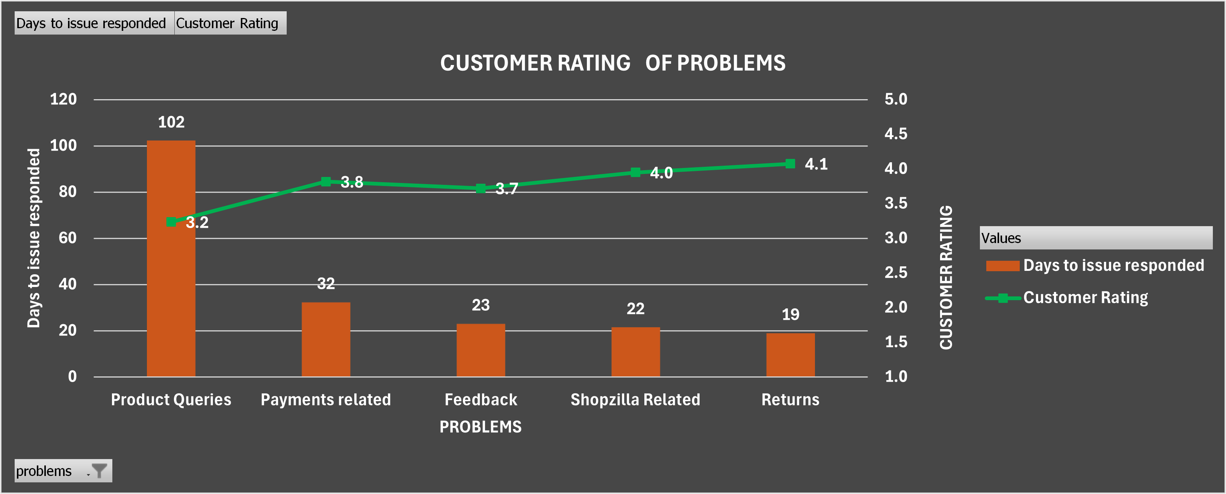
What is the Customer Rating of the problems that take the longest time to solving problems
Page
the graph shows that as the "Days to issue responded" decreases, the customer rating tends to increase.
6/12

Slide 7
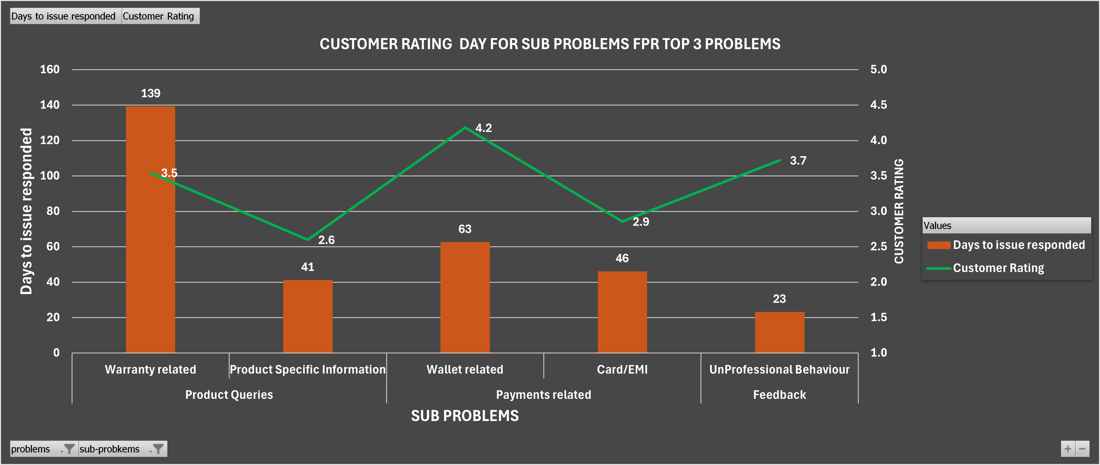
What is the Customer Rating of the sub problem for the top 3 problems that take the longest time?
The customer rating and response time (by days) for the subproblems under the "TOP 3 PROBLEMS" are broken out in detail in the graph.
Page
7/12

Slide 8
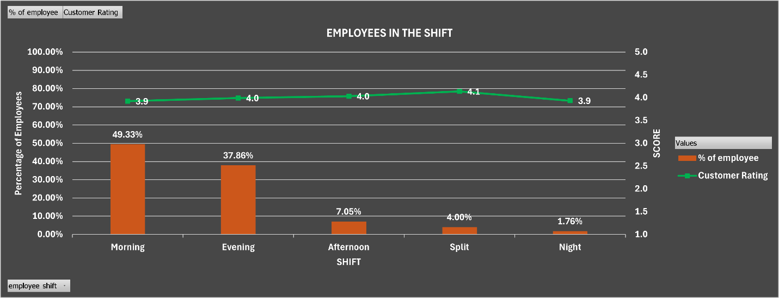
How does the scheduling of shift periods impact employees
(morning and evening) have slightly lower customer satisfaction scores than shifts (afternoon, split, night)
Page
8/12

Slide 9
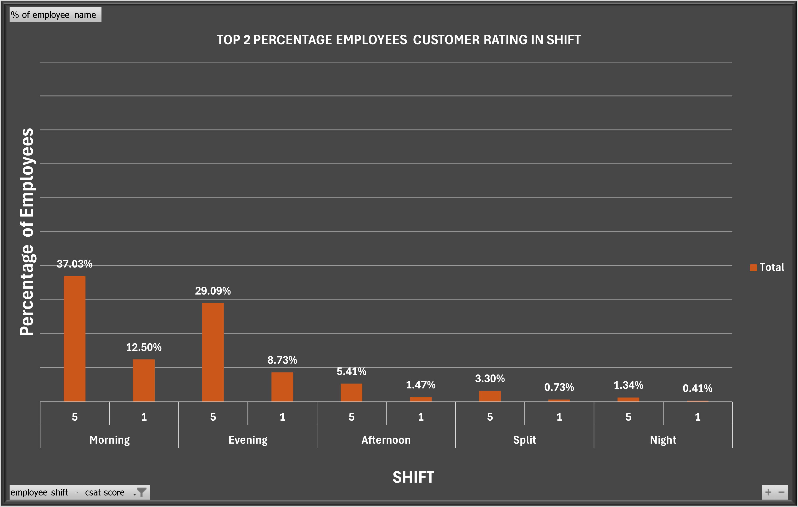
The highest 2 Customer Rating for the employee get in shifts?
(Morning and evening) shifts have the highest number of top performers, while (night) shifts have the lowest number of top performers.
Page
9/12

Slide 10
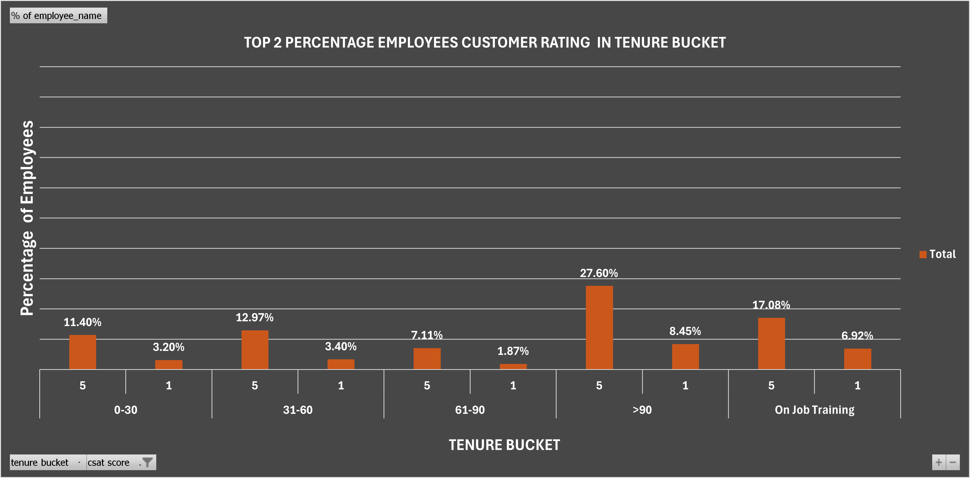
The highest 2 Customer Rating for the employee get in tenure bucket (employees insurance)?
Page
Employees with longer tenures (>90, 31-60) have higher performance than those with shorter tenures (0-30, 61-90). The “on-the-job training” category also has a relatively high proportion of top performers.
10/12

Slide 11
Recommendation
Enhance employee performance by implementing policies that promote longer tenures
Optimize shift scheduling to align with productivity patterns
Give addressing problems that take a long time priority.
Page
11/12

Slide 12
Thank You
Page
12/12

